Slide 1
College Accessibility for Students Experiencing Homelessness
Niya Kelly - Director of State Legislative Policy, Equity and Transformation
Alyssa Phillips – Education Attorney

Slide 2
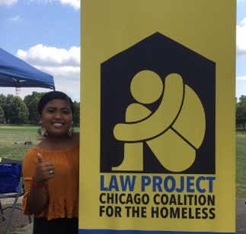
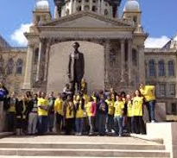
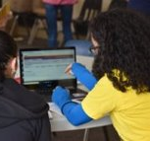
Chicago Coalition for the Homeless
The Chicago Coalition for the Homeless (CCH) organizes and advocates to prevent and end homelessness, because we believe housing is a human right in a just society.
CCH has a Policy Department, Organizing Department and Law Project.

Slide 3
Snapshot of Homelessness
The Illinois State Board of Education (ISBE) reported that public schools identified 53,696 homeless students in Illinois during the 2018-2019 school year.​
The current seating capacity for Wrigley Field is 41,268.

Slide 4
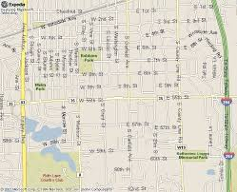
Snapshot of Homelessness
​
Chicago Public Schools identified 16,450 homeless students during the 2018-2019 school year.​
The current population of Hinsdale – a western suburb of Chicago - is 16,816.

Slide 5
Snapshot of Homelessness
Homelessness disproportionally impacts students of color.
98% of homeless students in Chicago Public Schools are students of color despite making up only 88.5% of total CPS students.
81% of homeless students are black despite making up 36% of the general CPS student population.

Slide 6
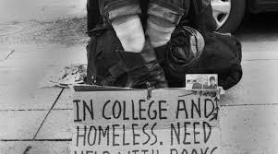
Background College Homelessness
Despite facing many challenges including deep poverty and instability many youth who experience homelessness wish to pursue careers that require some form of postsecondary education.
They are often invisible on campus, they are unsure if there are services available, confused on who or if they should turn to someone when problems arise. Students attempt to blend in because they want to be like other students despite their atypical circumstances.

Slide 7
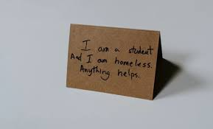
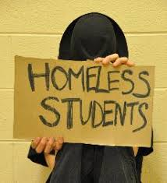
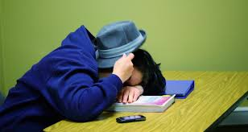
Need Identified
Chapin Hall at the University of Chicago’s study found that 4.2 million youth and young adults experienced homelessness on their own during a 12-month period.
The study also found that 29% of young adults who experienced homelessness were enrolled in college or another educational program at the time that they experienced homelessness.

Slide 8
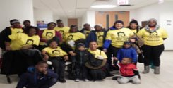
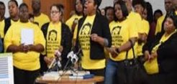
Legislative Proposal
Ask Illinois colleges and universities to designate a HOUSE (Housing and Opportunities that are Useful for Students’ Excellence) liaison for students experiencing homelessness and/or are students in care.
Create training for HOUSE liaisons to ensure they have the information needed to best serve the students.
Provide students experiencing homelessness and students in care priority for on- campus housing.

Slide 9
Legislative Proposal
Provide the opportunity for students experiencing homelessness and students in care to remain on campus during school breaks if on-campus housing remains open, ensuring they have access to housing as well as other necessities.
Ensure students experiencing homelessness and students in care leaving high school seamlessly matriculate into higher education
Require colleges and universities to identify students who are experiencing homelessness and report this information to Illinois Student Assistance Commission.
If after three academic years of tracking data universities and colleges with one percent of their student body experiencing homelessness or in care the liaison position will become a standalone position to best serve students.

Slide 10
Legislative Update
Because of COVID-19 Illinois General Assembly cancelled most session days, only returning for four days at the end of May to handle the state budget and legislation that was constitutionally required and other bills that related to COVID-19. Because the College Access Bill did not fit within this intense couple of days, we will have to run the bill again in the upcoming session.

Slide 11
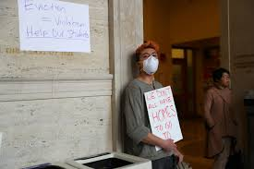
Trajectory
In the meantime students are in still in need maybe more than before. COVID-19 suddenness meant that students scrambled to leave their campuses and housing with little warning or time to prepare.
Students had to:
Find transportation back to their home bases, some without a home base to return.
Ensure they had a laptop and access to Wi-Fi.
Maintain their grades as they were unsure of their futures
Take care of their mental and physical health.

Slide 12
Alyssa Phillips 872.588.6800 aphillips@chicagohomeless.org
Niya Kelly 773.906.3435 niya@chicagohomeless.org

